Slide 1
Restless Leg Syndrome and BTBD9
http://siakhenn.tripod.com/snoring.html
Tara Pulvermacher

Slide 2
What Restless Leg Syndrome looks like
http://www.youtube.com/watch?v=k2eGoHk9AAc
http://www.ninds.nih.gov/disorders/restless_legs/detail_restless_legs.htm
Notes:
I want to start off with a video of what Restless Leg Syndrome looks like. As you can see this person her legs a lot! And this is because of a tight, burning, kind of creepy-crawly feeling in her lower legs that is so bad she can’t help but to move.

Slide 3
Restless Leg Syndrome facts
Neurological disorder
Low dopamine & Iron levels
5-10% of the population, 2x more in women
http://www.ninds.nih.gov/disorders/restless_legs/detail_restless_legs.htm
Freeman, A., et al. (2012). Sleep fragmentation and motor restlessness in Drosophila model of restless leg syndrome. Current Biology 22, 1142-1148. DOI 10.1016/j.cub.2012.04.027
Notes:
As you might expect, Restless Leg Syndrome is a neurological disorder and although the cause is unknown, low dopamine and iron levels have been found in many of the cases, so there definitely seems to be a correlation. I think it is really important to study Restless Leg Syndrome as it affects 5-10% of the population, and is twice as common in women, possibly because women are more prone to iron deficiency. (menstruation and pregnancy).

Slide 4
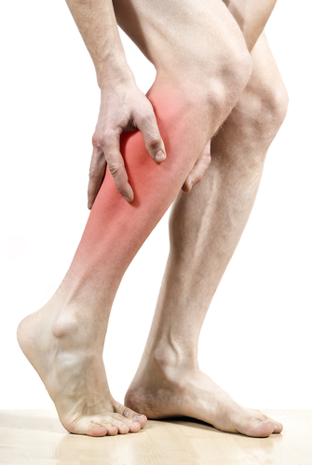
Treatment options
http://hotcigarettes.blogspot.com/2011/04/pack-of-cigarettes-stolen-at-gunpoint.html
http://www.webmd.com/sleep-disorders/restless-leg-syndrome-treatment
http://andrew03.pcgtheme.info/20120504-restless-leg-syndrome-nj/
http://www.stack.com/2013/02/19/how-to-stretch-your-calves/
http://www.ninds.nih.gov/disorders/restless_legs/detail_restless_legs.htm
http://www.walgreens.com/store/c/nature-made-iron-65-mg-dietary-supplement-tablets/ID=prod6031056-product
http://reachingutopia.com/how-does-caffeine-work/
http://thinkprogress.org/health/2013/02/19/1608671/alcohol-cancer-related-death/?mobile=nc
Notes:
You can choose to not treat RLS, which may be an ok option if your rls is not severe or not frequent
Alcohol, caffeine, and nicotine can make RLS symptoms worse
Self care: like stretching, exercise, massage, hot or cold packs and or showers
Medications: **Iron and dopamine. usually…dopamine agonists first-help relieve symptoms, dopaminergic agents, benzodiazapines-help you sleep through the symptoms, opiates-treat pain, usually-addictive though, so last option, anticonvulsants-relieve symptoms and chronic and nerve pain, alpha2 agonists-activate neurons that decreases involuntary muscle movements.

Slide 5
Mutations in BTBD9 cause Restless Leg Syndrome
Gene Ontology
Domains
regulation, orientation, binding, ubiquitination
BTB
BACK
F5/8 C Type
F5/8 C Type
http://smart.embl-heidelberg.de/
http://amigo.geneontology.org/cgi-bin/amigo/gp-assoc.cgi?gp=UniProtKB:Q96Q07&session_id=3022amigo1362771715
Notes:
The gene BTBD9 has recently been associated with Restless leg syndrome. So far, scientists have found 5 single nucleotie polymorphisms in the BTBD9 DNA that increase the risk of Restless Leg Syndrome but how or why is unclear. BTBD9 is expressed throughout the body, most highly expressed in the nervous system, particularly the brain where dopamine is produced and normal iron storage is essential.
We know the biological process of the BTBD9 protein is cell adhesion and that this protein has 4 domains-BTB, BACK, and two F5/8 type C domains, as you can see here. The functions of the domains are not know within the BTBD9 protein, although in other proteins these domains have been involved with transcriptional regulation, substrate orientation and binding to surface phospholipids, and protein ubiquitination. Ubiquitination is in red because I want you to remember that these domain are associated with protein ubiquitination. I am going to come back to this shortly.

Slide 6
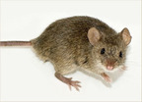
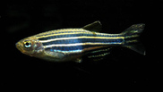
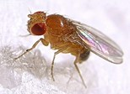
BTBD9 is well conserved
0
100
200
400
600
700
BTBD9
612
BTB
BACK
F5/8 C Type
F5/8 C Type
BTBD9
612
BTB
BACK
F5/8 C Type
F5/8 C Type
BTBD9
612
BTB
BACK
F5/8 C Type
F5/8 C Type
F5/8 C Type
btbd9
602
BTB
BACK
CG1826
722
BTB
BACK
Hpo-9
581
BTB
BACK
F5/8 C Type
http://smart.embl-heidelberg.de/
http://www.ncbi.nlm.nih.gov/HomoloGene/HGDownload.cgi?hid=14995
http://natureafield.com/tag/c-elegans/
http://images.yourdictionary.com/homo-sapiens
http://www.ci.berkeley.ca.us/Health_Human_Services/Environmental_Health/Control___Preventions_of_Rodents.aspx
http://www.seymourfish.com/zebra-danio-care/
http://www.taxateca.com/ordendiptera.html
http://www.redorbit.com/news/science/2055610/research_team_maps_lab_mouse_genome/
Notes:
The BTBD9 protein is very well conserved. As you can see, the human, mouse and rat BTBD9 homologues are all 612 amino acids and have the same domains, in the same positions. I also want to note that the BTB and BacK domains are in all of these model organisms, so I decided to focus more on these domains.

Slide 7
BTBD9 mutant phenotype is well conserved
http://www.youtube.com/watch?v=T7sF_czJpJQ
Freeman, A., et al. (2012). Sleep fragmentation and motor restlessness in Drosophila model of restless leg syndrome. Current Biology 22, 1142-1148. DOI 10.1016/j.cub.2012.04.027
http://natureafield.com/tag/c-elegans/
http://www.redorbit.com/news/science/2055610/research_team_maps_lab_mouse_genome/
http://www.taxateca.com/ordendiptera.html
Notes:
Not only is the protein conserved, but so is the mutant phenotype. Studies in flies, mice, and worms have mutated the BTBD9 gene and found a restless legs phenotype. This video is from a study done with flies in which the researchers mutated the BTBD9 gene. The BTBD9 mutant flies appear to display the same phenotype as humans. There is definitely increased locomotion.

Slide 8
BTBD9 localizes with Cullin 3 (Ubiquitin protein)
Freeman, A., et al. (2012). Sleep fragmentation and motor restlessness in Drosophila model of restless leg syndrome. Current Biology 22, 1142-1148. DOI 10.1016/j.cub.2012.04.027
Notes:
In the same study, they found BTBD9 to localize with cullin3, a ubiquitin protein. Only fly BTBD9 protein tagged in top, both proteins tagged in the bottom. Cullin 3 is also present in people and many other animals, like worms and mice.

Slide 9
BTBD9 interacts with ubiquitination proteins
http://string-db.org/newstring_cgi/show_input_page.pl
Notes:
I took a look at the most closely linked proteins to BTBD9 on the string site and found USP25 and 21 which are both involved in protein ubiquitination. From here I decided BTBD9 is definitely related to ubiquitination somehow, and I wanted to look more into this.

Slide 10
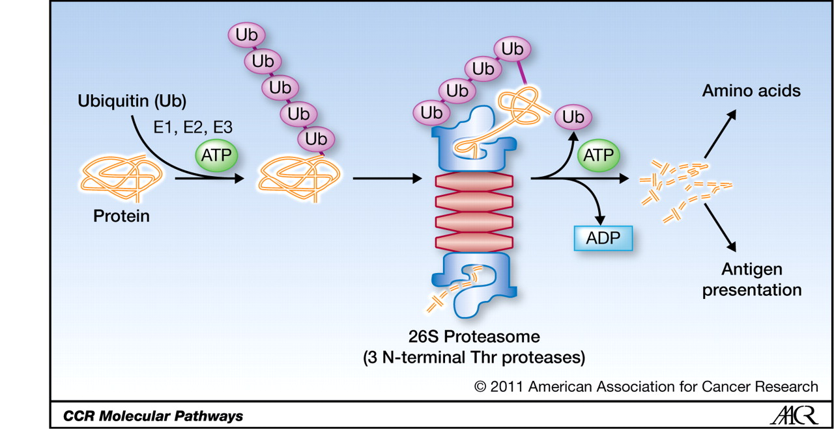
Ubiquitin is involved in protein degradation
Cullin3
BTBD9
http://clincancerres.aacrjournals.org/content/18/1/15/F1.expansion.html
http://www.genecards.org/cgi-bin/carddisp.pl?gene=CUL3
Freeman, A., et al. (2012). Sleep fragmentation and motor restlessness in Drosophila model of restless leg syndrome. Current Biology 22, 1142-1148. DOI 10.1016/j.cub.2012.04.027
Notes:
Now for a quick refresher on protein degradation by ubiquitination. In this pathway, a protein, such as BTBD9, is targeted for degredation by a ubiquitin ligases-like cullin3. This ubiquitin ligase adds polyubiquitin chain to one or more lysine amino acids on the target protein. This ubiquitinated protein will then be transported to a proteasome where the ubiquitin will be removed, the protein unfolded, and translocated inside the proteosome for degradation into peptide fragments.

Slide 11
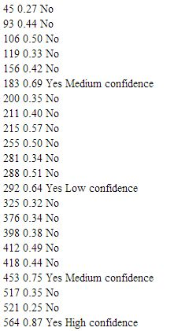
Where are the ubiquitination sites in BTBD9?
BTBD9 FASTA sequence
Used UbPred.org
4 sites
BTB
BACK
F5/8 C Type
F5/8 C Type
Ubpred.org
Notes:
I took the BTBD9 FASTA sequence and put it into this website ubpred.org, a site that predicts ubiquitination sites in a protein and I found 4 predicted sites of ubiquitination. My results are shown on the right, you can see position 183, 292, 453, and 564 have been predicted. I’ve also shown in red where the ubiquitination sites are.

Slide 12
Ubiquitination site 183 is in the BACK domain
BTB
BACK
F5/8 C Type
F5/8 C Type
0
100
143
200
240
300
400
500
600
183
http://www.wormbook.org/chapters/www_ubiquitinpathways/ubiquitinpathways.html
http://smart.embl-heidelberg.de/
Notes:
Ubiquitination site at position 183 is within the BACK domain. Since all model organisms I looked at had a conserved BACK domain and phenotype, I decided this ubiquitination site may be important. Also, Cullin-3 ubiquitin ligase has been shown to bind a BTB domain in worms, so it is possible the BTB domain may bind cullin-3 in which the BACK domain, in close proximity, could easily be ubiquitinated.

Slide 13
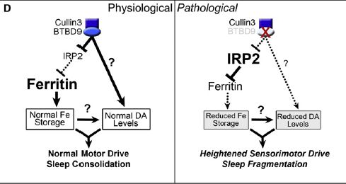
Hypothesis
Ubiquitination of the BACK domain is important for iron metabolism.
Freeman, A., et al. (2012). Sleep fragmentation and motor restlessness in Drosophila model of restless leg syndrome. Current Biology 22, 1142-1148. DOI 10.1016/j.cub.2012.04.027
Notes:
So I hypothesized that ubiquitination of the BACK domain is important for iron metabolism. This diagram shows the relationship of BTBD9, the ubiquitin ligase cullin-3, and iron metabolism.
Fly paper demonstrates BTBD9’s function as a substrate adaptor for the Cullin-3 class of E3 ubiquitin ligases. They show Cullin3 and BTBD9 binding, and when they do they suppress IRP2-which I said decreases the amount of iron stored, therefore allowing iron to be stored normally, which somehow results in normal dopamine levels. However, when BTBD9 is not present, IRP2 levels are high and iron is not stored as it should be. My hypothesis is that ubiquitination of the BACK domain of BTBD9, leads to BTBD9 degredation and therefore low levels of iron storage.
Parkinson’s and Alzheimer's are associated with iron overload, RLS and ADHD are associated with iron deficiency

Slide 14
Hypothesis
Ubiquitination of the BACK domain is important for iron metabolism.
Freeman, A., et al. (2012). Sleep fragmentation and motor restlessness in Drosophila model of restless leg syndrome. Current Biology 22, 1142-1148. DOI 10.1016/j.cub.2012.04.027
Notes:
Fly paper demonstrates BTBD9’s function as a substrate adaptor for the Cullin-3 class of E3 ubiquitin ligases. They show Cullin3 and BTBD9 binding, and when they do they suppress IRP2-which I said decreases the amount of iron stored, therefore allowing iron to be stored normally, which somehow results in normal dopamine levels. However, when BTBD9 is not present, IRP2 levels are high and iron is not stored as it should be. My hypothesis is that ubiquitination of the BACK domain of BTBD9, leads to BTBD9 degredation and therefore low levels of iron storage.
Parkinson’s and Alzheimer's are associated with iron overload, RLS and ADHD are associated with iron deficiency

Slide 15
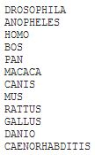
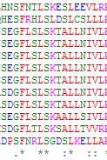
Is the BACK domain ubiquitination site conserved?
BTB
BACK
F5/8 C Type
F5/8 C Type
1
612
BTBD9 protein FASTAs
Align with Clustal W2
Position 183
K=Lysine=ubiquitination
http://www.ubpred.org/
http://www.ebi.ac.uk/Tools/services/web/toolresult.ebi?jobId=clustalw2-I20130418-220601-0844-86308553-pg&tool=clustalw2&showColors=true
http://www.phosphosite.org/proteinAction.do?id=1473
Notes:
K is the letter for Lysine amino acid, which can be ubiquitinated. You can see in the clustal w alignment that anopheles and c. elegans had mutations that did not allow for a homologous ubiquitination sites.

Slide 16
Are the sites conserved in animals without legs?
BTB
BACK
F5/8 C Type
F5/8 C Type
http://www.ubpred.org/
http://www.ebi.ac.uk/Tools/services/web/toolresult.ebi?jobId=clustalw2-I20130418-220601-0844-86308553-pg&tool=clustalw2&showColors=true
Notes:
I looked at my clustal w2 alignment for each ubiquitination site and I noticed C. Elegans were mutated at all sites, so no ubiquitination=no degredations of BTBD9=iron and dopamine levels remain normal and no RLs? Worms already move a lot, so maybe they don’t get RLS?

Slide 17
Does BTBD9 function without BACK ubiquitination site?
http://www.ubpred.org/
http://www.ebi.ac.uk/Tools/services/web/toolresult.ebi?jobId=clustalw2-I20130418-220601-0844-86308553-pg&tool=clustalw2&showColors=true
Notes:
Re-place the worm amino acid into the Fly gene. Could do a Western blot to detect for the presence of BTBD9 protein. Or 2D gel electrophoresis and Maldi-TOF.

Slide 18
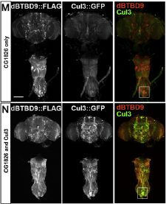
Does this mutated fly BTBD9 still function?
Western blot
Tag BTBD9 and Cullin3
Iron
Expectation: BTBD9 functions
Freeman, A., et al. (2012). Sleep fragmentation and motor restlessness in Drosophila model of restless leg syndrome. Current Biology 22, 1142-1148. DOI 10.1016/j.cub.2012.04.027
Notes:
Transgenically express BTBD9 and cul3 with a FLAG tag and GFP tag, as is was originally done. Expect fly to appear normal since doesn’t get ubiquitinated-ubiquitination site is gone. Iron should be normal in mutated and control flies. And cullin 3 should co-localize. Expect BTBD9 to still function without the ubiquitination site.

Slide 19
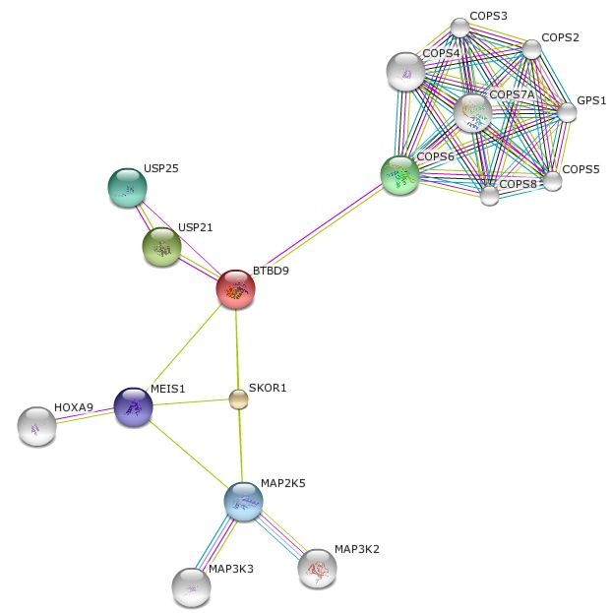
Why is restlessness only in the legs?
http://string-db.org/
Notes:
I looked at the protein interaction network using the String website and found a Hox gene. Hox genes are an important factor for the layout of the body plan in developing animals So, maybe this provides the positional factor to Restless Legs

Slide 20
Where is HoxA9 localized?
http://linkinghub.elsevier.com/retrieve/pii/S0140673603141876?via=sd
Notes:
OMG! Right in the calves! Although BTBD9 is expressed throughout the human body, maybe HoxA9 leads to higher amounts of BTBD9 here in the calves? New hypothesis?

Slide 21
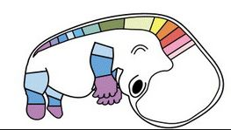
Hypothesis
HoxA9 localizes BTBD9 in the lower legs
http://linkinghub.elsevier.com/retrieve/pii/S0140673603141876?via=sd

Slide 22
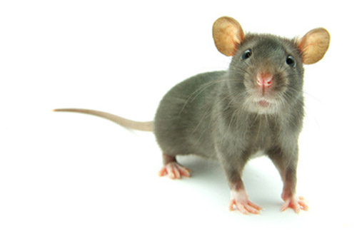
What if I knocked out HoxA9?
Expectations:
Dispersed BTBD9
Widespread restlessness
Less severe
http://www.genengnews.com/gen-news-highlights/crescendo-claims-triple-knockout-mice-lack-igh-and-kappa-lambda-light-chains/81244000/
Notes:
So observe restlessness throughout the body, maybe less severe since not as localized?
Use a mouse because BTBD9 is so similar. Have generated BTBD9 mutant mice which show restless leg syndrome phenotype. Increased locomotion, increased awake time during sleep, increased sensitivity in leg muscles.
Delete HoxA9 using RNAi or generate a knockout mouse and observe for rls at all and restlessness in other areas. Do DNA microarray to measure expression levels of BTBD9 and cullin-3. Tag BTBD9 to see where it is localized. Do tests to determine if mouse has restlessness and muscle sensitivity elsewhere.
Variants in BTBD9 that predispose to restless legs syndrome and periodic limb movements during sleep are also associated with TS -http://www.ncbi.nlm.nih.gov/pubmed/19822783

Slide 23
Another disorder associated with BTBD9
Tourette
Syndrome
https://www.healthtap.com/#topics/syndrome-gilles-de-la-tourette-traitement
Rivière JB, et al.,(2009). Association of intronic variants of the BTBD9 gene with Tourette Syndrome. Arch Neurol. 66(10). doi: 10.1001/archneurol.2009.213.
http://linkinghub.elsevier.com/retrieve/pii/S0140673603141876?via=sd
Notes:
Tourettes is like restless leg syndrome in the head kind of. In the future it may be interesting to look into if HoxA1 or HoxA2 is important in tourette’s patients.

Slide 24
Future studies
Develop gene ontology and protein-protein interaction network
Identify BTBD9 domain functions
Analyze ubiquitination sites: legs, no legs, wings
Drug development to block ubiquitination sites
Notes:
Many future studies to be done. Gene ontology needs to be further developed, since we only have one entry for biological process. I only looked into one ubiquitination site, but it may be wise to look at the others as well, especially since C.elegans do not have the conserved ubiquitination site in the BACK domain but in unpublished research they have found to display restless leg syndrome phenotype with mutation to the homologous BTBD9 gene. Identify protein-protein interactions with Y2H

